Slide 1
President’s Report
Fall 2022 Plenary
Purchase College

Slide 2
Our year together
Fall Planning Meeting
Saratoga
Sep 8-9
Fall Plenary
Purchase
Oct 20-22
Winter Plenary
Virtual
Jan 19-21
Spring Plenary
Upstate Medical
Apr 13-15
Summer Planning Meeting next June
Plenary preview
Campus visits
http://www.sunyufs.us/plenaries--meetings.html

Slide 3
On the radar, from SUNY
General Education
GE framework website
Guidance document and rubric
Upcoming MTP & comment period
DEISJ capacity building
Prior Learning Assessment
Categories of PLA
Consistency across campuses
Student mobility / seamless transfer
Transfer paths, transfer issues, transfer tools
DLE / Brightspace implementation & governance

Slide 4
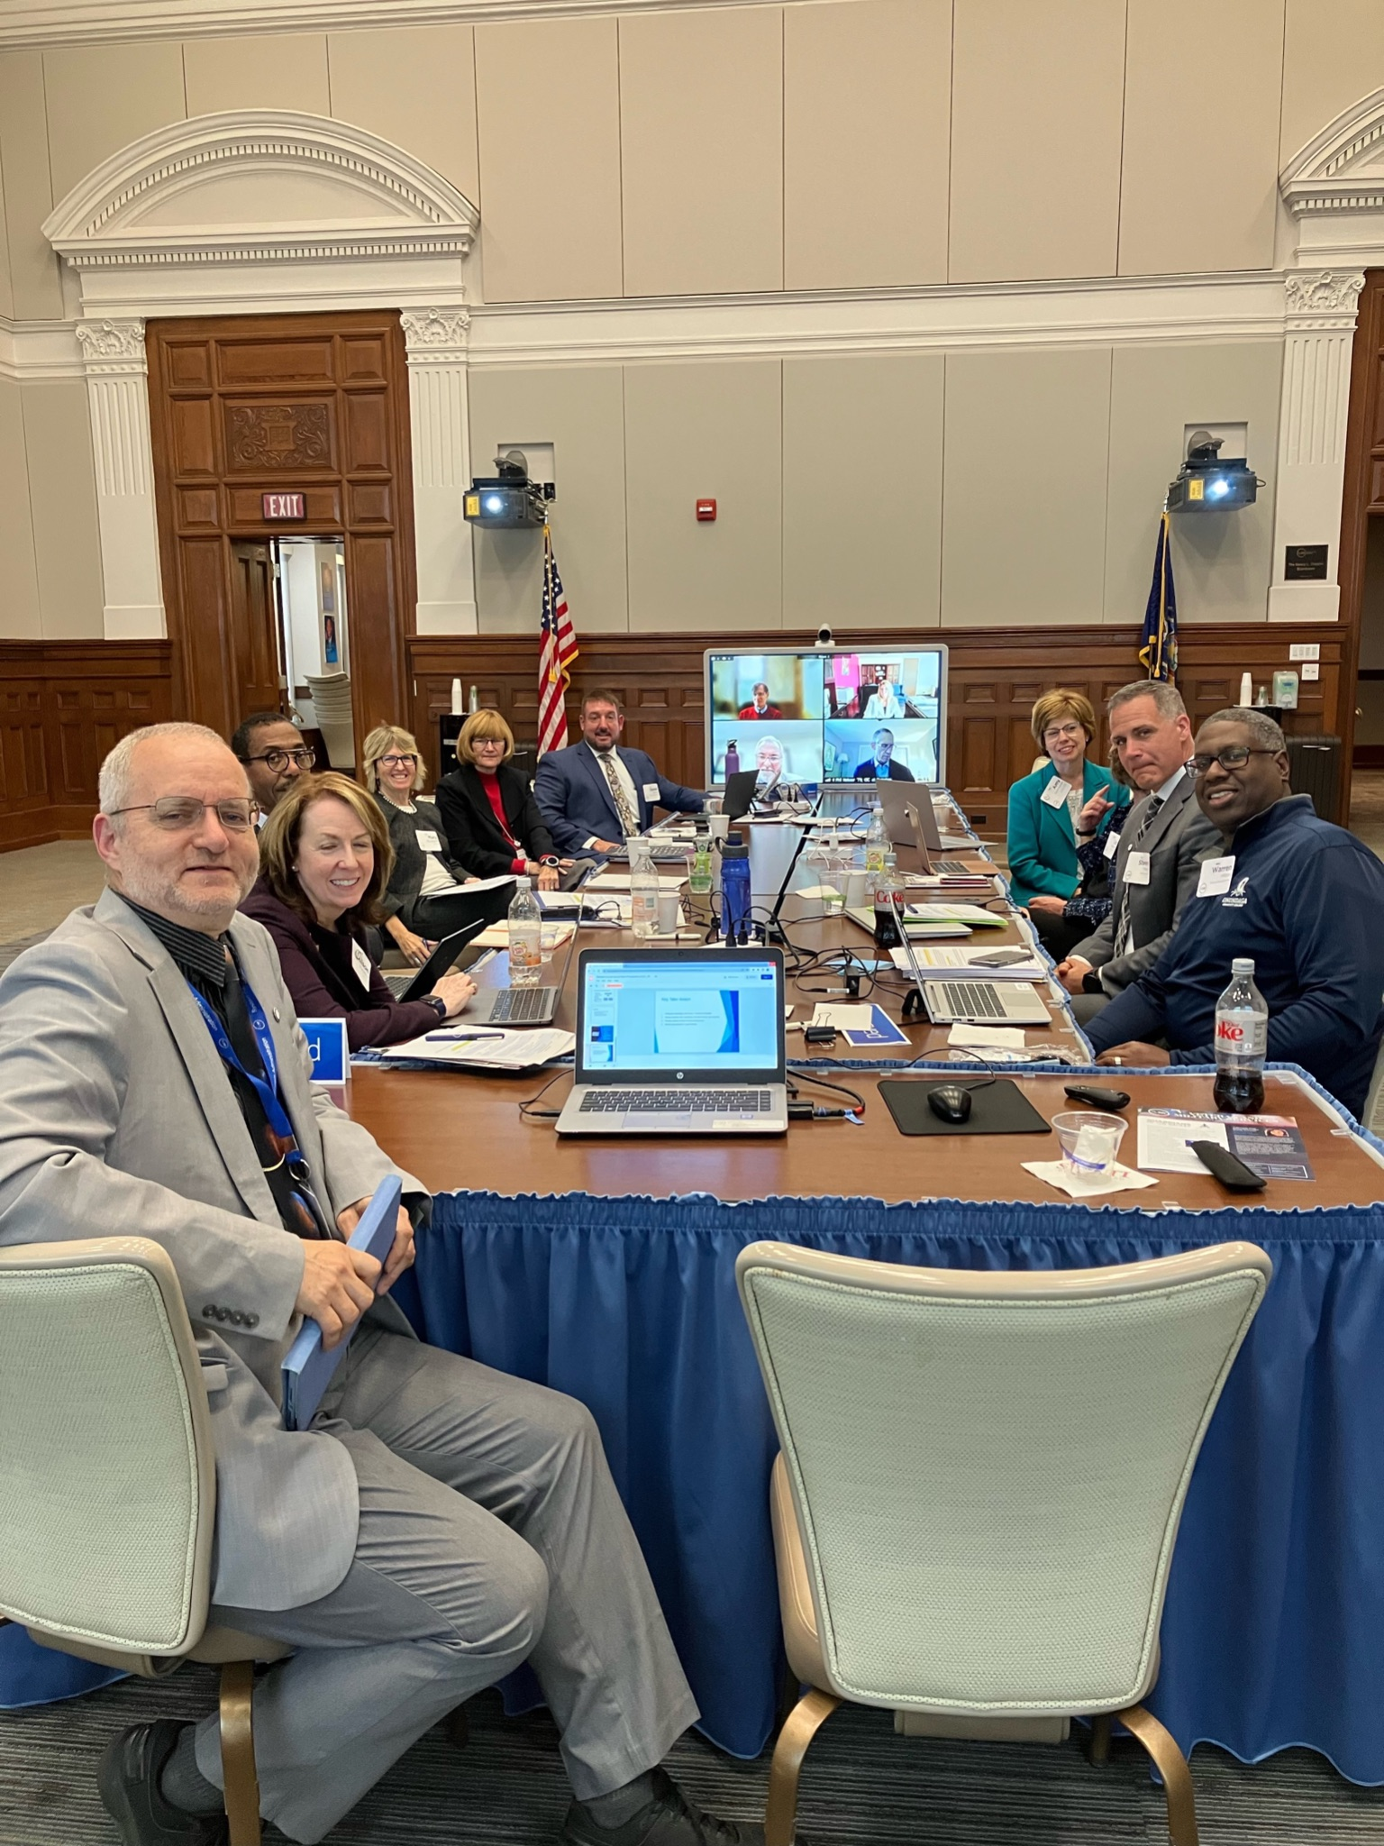
The bigger SUNY picture
State of the State / Budget
SUNY focus in SotS
New funds
Big Ideas
Searches and inaugurations
Chancellor and System Admin leadership team
President searches
Onboarding new Presidents & OIC’s
Board of Trustees
Meetings, archives
Issues

