Slide 1
Covid Pandemic Reflections:
How “What Was” is Informing “What Will Be”
Presented by the UFS Undergraduate Academic Programs & Policies Committee
Presented at the University Faculty Senate Plenary - Fall 2022
Workshop Facilitators: Wendy Gordon and Anna Bates

Slide 2
Goals for Session
Identify resilient pedagogical strategies/skills that work better than pre-pandemic methods
Provide closure for pandemic experiences
Community building of Plenary attendees
Extracting value from pandemic experience and identifying system-level needs for the future
Possibility of creating a repository of effective instructional strategies informed by the pandemic

Slide 3
Covid - 19 Pandemic
March 11th 2020

Slide 4
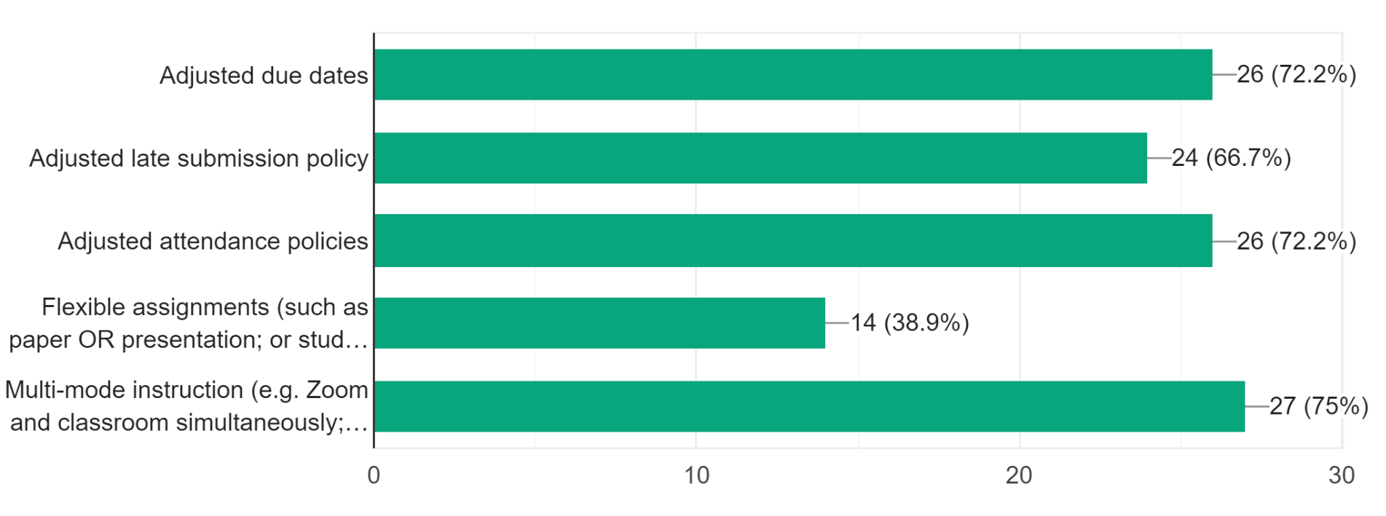
Preliminary Fall 2022 Survey Results
38 responses, 11 different SUNY Locations
Broadly speaking, to what extent have you felt supported by your campus/administration as you have adapted to pandemic conditions? | 83.7% rated 3 or better
Topic Area | Perceived Campus /Admin Support
Instruction methods and delivery (adapting your teaching to changed circumstances) | 55% - 3 or less 45% - 4 or 5
Student support and accountability (your ability to help students succeed academically, including knowing where to send them for additional help). | 56 % - 3 or less 44% - 4 or 5
Personal work/life balance (care for children, parents or partners while also completing work responsibilities; support for remote work; acknowledgement of the extra time/effort required for shifting to or teaching in multiple modalities) | 85 % - 3 or less 15 % - 4 or 5
Public Health (information about campus policies, availability of testing/vaccinations, confidence in cleaning and policy enforcement) | 43 % - 3 or less 57 % - 4 or 5
Which of these strategies have you personally used to adapt to pandemic conditions? (You may check all that apply)

Slide 5
Narrative Responses
Is there anything that you did differently during the pandemic that you will continue to use post-covid era?
“Yes— more flexibility as is possible, more overt attention to pedagogy, leaning more towards a “less is more” approach to syllabus planning”
“Video recording and online class discussion”
“One-on-one meetings on Zoom. Frequent private check-ins with students to see how they are doing. Stopping to ask how students are doing more frequently and talking about ways of navigating workload and stress.”
“Remote review sessions before exams. Online, pre-recorded makeup lectures if classes need to be cancelled.”
“I will continue with universal design for learning principles.”
“Everything. Quite seriously, I learned a lot about what was necessary and what wasn't.”

Slide 6
Narrative Responses
Please share as much as you would like about your thoughts on the points raised in this survey.
“Thanks for asking for our input. I think that the administration supported us and faculty did the best they could in difficult circumstances.”
“I feel as if the campus message was that we had to show maximum support and flexibility as regards the stresses that students were experiencing during the pandemic, but no one bothered to consider the soul-crushing stress faculty underwent as they struggled to reinvent their teaching in a short amount of time. And as we kept up a brave face, we felt as if we were abandoned to our own physical, emotional, pedagogical and spiritual resources to cope with this extremely difficult situation. It seemed that the campus administration would talk about a “morale crisis” and “burnout” of faculty - but I saw little evidence of any efforts to address these issues in any substantive manner.”
“Instructional support - loads of support, but we can't invent time to LEARN it and APPLY it because of increased workload.”
“Support that faculty feel is directly proportional to resources allocated. When resources are limited, faculty don't feel supported since their activities are not invested in. Money matters! Money translates into time, resources, compensation for real valued work.”

Slide 7
Discussion Activity
Break in to pairs with members of your sector
Review the questions provided in your Plenary packet
Discuss each question and record your answers
Share your most notable answers with the group in the large group discussion
Please return your question packet to the presenters for further data collection

Slide 8
Academics
How did you and your colleagues adapt to pandemic teaching?
What one or two changes have you carried into the current semester?
What changes are still needed to support faculty and students?
Do you have any new best practices learned during the pandemic you will carry into your future work?
Professionals
How did/has the pandemic changed the way you do your job now and in the future?
Are there changes that need to be walked back?
What adaptations are still needed?
Do you have any new best practices learned during the pandemic you will carry into your future work?
Health Sciences (or answer Academics or Professionals if that is more relevant to your position/experience)
How did/has the pandemic changed the way you do your job now and in the future?
Should some changes be reversed?
Are there additional supports needed to make it possible to sustain beneficial changes?
Do you have any new best practices learned during the pandemic you will carry into your future work?

Slide 9
Thank you for your participation!

